Slide 1
Weather Forecast project
Group:-
Aayush kumar-2000910130001
Ankit kumar- 2100910139003
Devraj singh- 2100910139005
Aditya sharma- 2000910130005

Slide 2
ABOUT THE PROJECT
This is a weather forecasting webhosting in which we collect the weather information from the API integration
With the help of this web page we can check the whether of any city by simply feeding the input through the search column given inside the page.

Slide 3
OUR IDEA
WE TEND TO CREATE AN ACCURATE WEATHER FORECAST SITE WITH SOME SPECIAL SPECIFICATION
WE USED HTML,CSS AND JAVASCRIPT TWO CREATE THE WEB PAGE
WE ALSO CREATED HEADER AND FOOTER WITH CONTACT DETAILS
AN ERROR 404 PAGE IS DISPLAYED IF WE FEED WRONG INPUT THAT DOESN’T EXIST.
THE WEATHER UPDATION IS ATTACHED TO THE API SERVER AND IYT GET UPDATED TIME TO TIME.
IF THE USER HAS A PROBLEM THEN THEY CAN CONTACT US THROUGH THE ABOUT US SECTION.

Slide 4
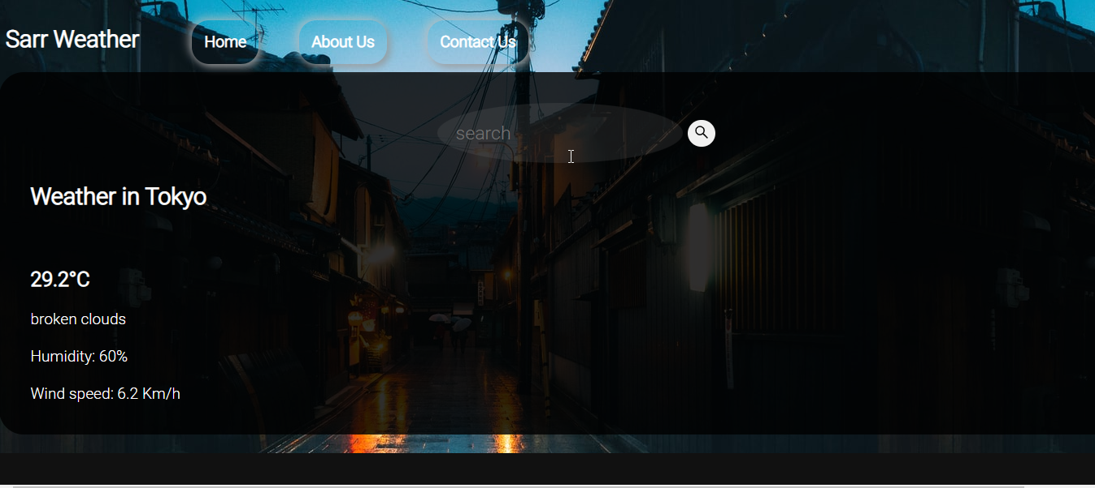
MAIN FRAME

Slide 5
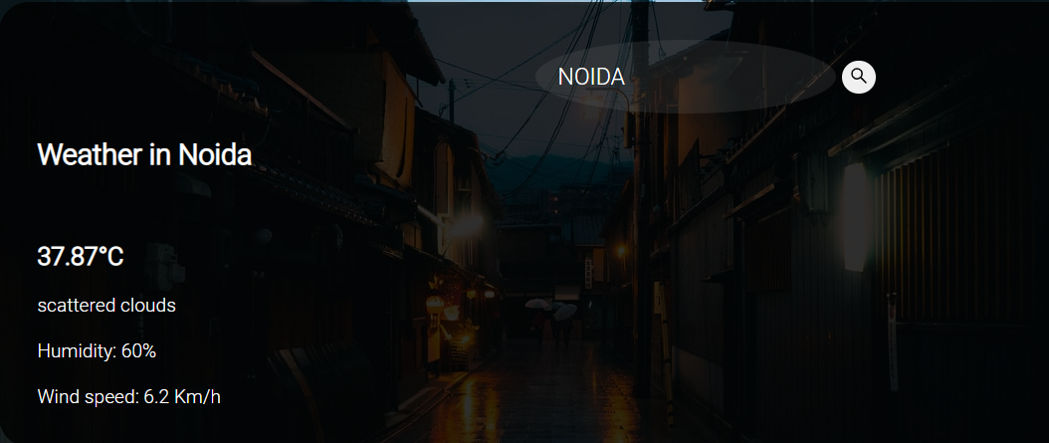
WEATHER OF SPECIFIC LOCATION

Slide 6
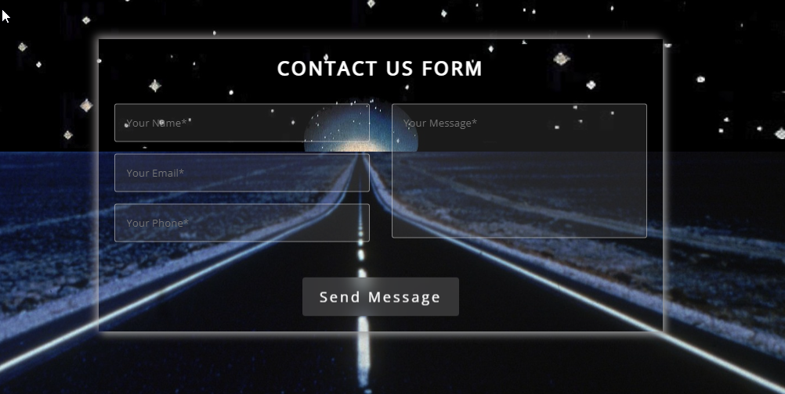
QUERY FORM

Slide 7
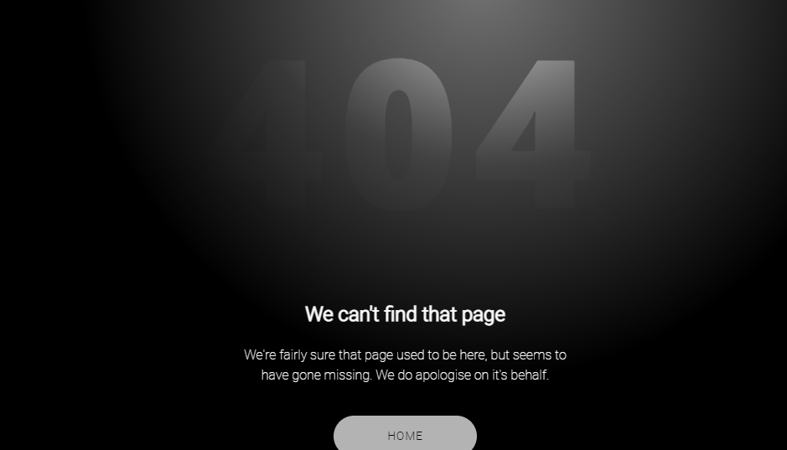
ERROR PAGE

Slide 8

POP-UP MESSAGE:

Slide 9
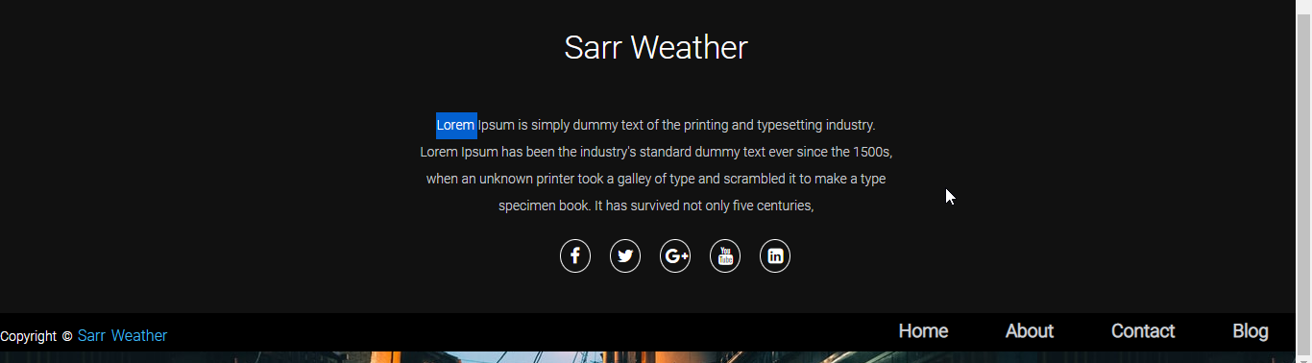
ABOUT US

